Slide 1

SLIDE 1
TEAM MINERVA
Members –
1. ABHINAV MADHAV JASRASARIA ( LEADER)
6901771247
2. VARUN GATTU
8897063003
3. VARUN JINDAL
8527665882
4. RAGHAVENDRA JADHAV
9967046515
5. NAGA VENKATA SAI RUTHVIK KASI
+971 504130711
Domain name – Open Innovation
Problem statement – Saving lives during an accident.

Slide 2
SLIDE 2
ABSTRACT
In third world countries, driving motorbikes is common. The accidents which occur while riding a motorbike are much more fatal than while driving a car. Many people loose their lives, because they don’t reach hospital in time. Statistics show that this is the case in 27% of accidents occurring in India. Due to this we have come up with a device which can detect your accident and contact the emergency number. This device will be extremely useful if an accident occurs and it will ensure ambulance reaches you in the least time possible.

Slide 3
SLIDE 3
NOVELTY
We plan on modifying motor bike helmet, in order for it to detect an accident and report it to the hospital along with the location of the accident. This will be a life saving invention and we believe that it can save many lives especially in over populated countries where people drive motor bike like India. This product has never been implemented and no kind of prototypes are available in the market.

Slide 4
SLIDE 4
TECHNOLOGY STACK
Microcontroller: Arduino uno
GSM Module: SIM 900AGPS
Module: AB6
Rhydo labz arduino sheildApp developed in: Android app
Studio Maps: Google Maps
Sensor: GPS tracking sensor, GY-53 VL53L0X Laser detecting sensor
Source: Solar Pannel

Slide 5
SLIDE 5
IMPLEMENTATION
It can be implemented all over the world, especially in countries where people drive more motor bikes like India, Thailand etc. People will accept it with open hands and it will be an industrial revolution because today’s generation doesn’t compromise when it comes to safety of their lifes. This product can be sold online as well as in the normal helmet selling stores. As it charges on its own using solar energy, its much more easier to use.

Slide 6
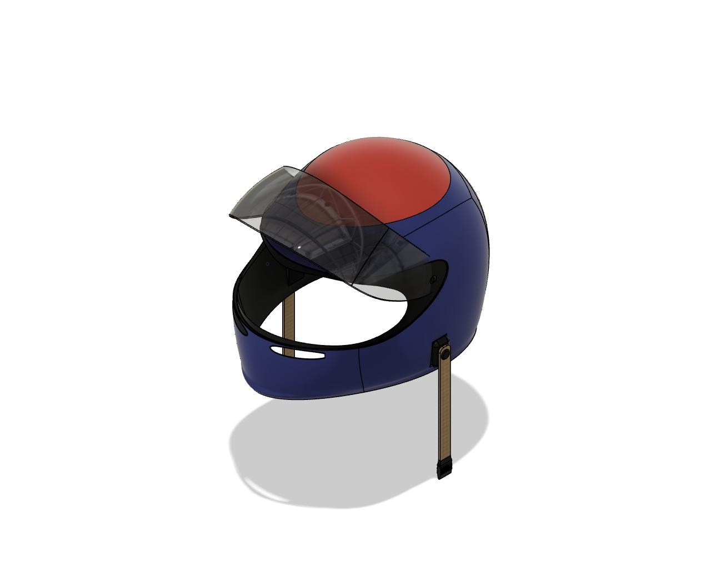
SLIDE 6
BUSINESS SCOPE
While the cost varies from helmet to helmet, the estimated cost would be somewhere around 400 to 450 rupees more than the cost of the helmet chasis. We believe that 500 rupees should not matter when it comes to saving ones life and people will not hesitate to buy the product. India in itself with 37 million motorcycles has a huge market for our product. Not only this we can expand the same product to countries like China, Indonesia and Vietnam having 34 million, 107 million and 97 million motorcycles respectively.

Slide 7
SLIDE 7
PRODUCT SAFETY
Our product doesn’t compromise the safety of the helmet. All the circuit is placed in between chasis and inner cushion of the helmet. With a sensor on left, right and in front of the helmet, it will make sure to send the message and GPS location even in the worst case senarios.
FUTURE ADVANCEMENTS
In the future this device can be updated to contact the nearby hospital rather than the emergency number.

